Slide 1
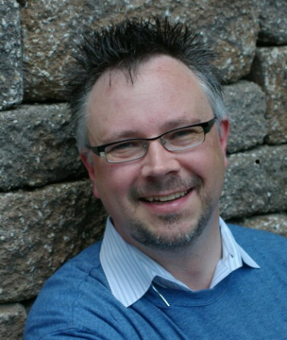
Software Application Security Testing
BDD and TDD Application Security Testing robertGrupe, CISSP, CSSLP, PE, PMP
Tags :: OWASP, Threat Modeling, Application, Software, Security, Development, AppSec, DevOps, DevSecOps, STRIDE, DREAD, SSDLC
Notes:
Bio
From Fortune 100 to start-up companies, Robert Grupe is an international professional with practitioner, leader, and consultant experience in market strategy, development, and support for global leaders in aerospace, electro-optic, information security, and health care industries.
Robert is a registered Certified Information Security Professional (CISSP), Certified Secure Software Lifecycle Professional (CSSLP), and Project Management Professional (PMP).

Slide 2
Table of Contents
TBD

Slide 3
Tools
IriusRisk
Connects with several tools (OWASP ZAP, BDD-Security, Threadfix...) to empower automation
Notes:
https://en.wikipedia.org/wiki/Threat_model#Threat_Modeling_Tools
https://www.microsoft.com/en-us/download/details.aspx?id=49168
http://threatmodeler.com/

Slide 4
Resources
OWASP Testing

Slide 5
Finis
Robert Grupe, CISSP, CSSLP, PE, PMP
robert@rgrupe.com
+1.314.278.7901

